Slide 1
SS G515 - Data Warehousing
Dr. Yashvardhan Sharma
Assistant Professor, CS & IS Dept.
BITS-Pilani

Slide 2
Data Marts
What is a data mart?
Advantages and disadvantages of data marts
Issues with the development and management of data marts

Slide 3
Data Marts
A subset of a data warehouse that supports the requirements of a particular department or business process
Data Mart is a subset of corporate-wide data that is of value to a specific groups of users. Its scope is confined to specific, selected groups, such as marketing data mart.
Characteristics include:
Does not always contain detailed data unlike data warehouses
More easily understood and navigated
Can be dependent or independent

Slide 4
Data Marts
Data Mart: A scaled-down version of the data warehouse
A data mart is a small warehouse designed for the department level.
It is often a way to gain entry and provide an opportunity to learn
Major problem: if they differ from department to department, they can be difficult to integrate enterprise-wide

Slide 5
Reasons for Creating Data Marts
Proof of Concept for the DW
Can be developed quickly and less resource intensive than DW
To give users access to data they need to analyze most often
To improve query response time due to reduction in the volume of data to be accessed

Slide 6
Kimball vs Inmon
Bill Inmon's paradigm: Data warehouse is one part of the overall business intelligence system. An enterprise has one data warehouse, and data marts source their information from the data warehouse. In the data warehouse, information is stored in 3rd normal form.
Ralph Kimball's paradigm: Data warehouse is the conglomerate of all data marts within the enterprise. Information is always stored in the dimensional model.

Slide 7
Kimball vs Inmon
Bill Inmon: Endorses a Top-Down design
Independent data marts cannot comprise an effective EDW. Organizations must focus on building EDW
Ralph Kimball: Endorses a Bottom-Up design
EDW effectively grows up around many of the several independent data marts – such as for sales, inventory, or marketing

Slide 8
Kimball vs Inmon: War of Words
"...The data warehouse is nothing more than the union of all the data marts...,"
Ralph Kimball, December 29, 1997.
"You can catch all the minnows in the ocean and stack them together and they still do not make a whale,"
Bill Inmon, January 8, 1998.

Slide 9
Kimball vs. Inmon
There is no right or wrong between these two ideas, as they represent different data warehousing philosophies. In reality, the data warehouse in most enterprises are closer to Ralph Kimball's idea. This is because most data warehouses started out as a departmental effort, and hence they originated as a data mart. Only when more data marts are built later do they evolve into a data warehouse.

Slide 10
Data Warehousing Process
Enterprise-wide warehouse, top down, the Inmon methodology
Data mart, bottom up, the Kimball methodology
When properly executed, both result in an enterprise-wide data warehouse

Slide 11
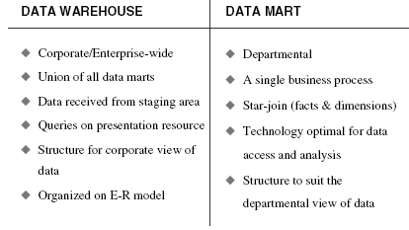
Data warehouse versus data mart.

Slide 12
Building a Data Mart
Questions to be asked:
Top-down or bottom-up approach?
Enterprise-wide or departmental?
Which first—data warehouse or data mart?
Build pilot or go with a full-fledged implementation?
Dependent or independent data marts?

Slide 13
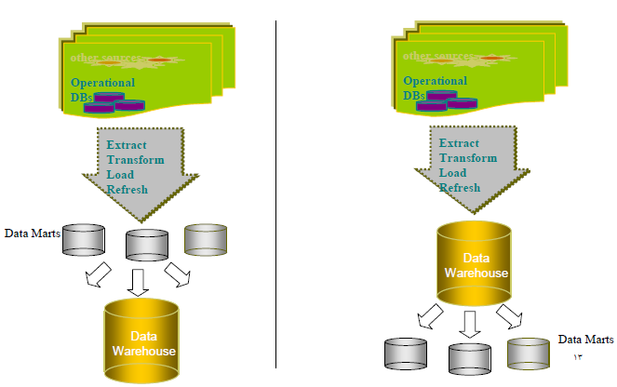
Bottom-Up Versus Top-Down Approach

Slide 14
Data Warehouse or Data Mart First?
Top-Down vs. Bottom-Up Approach
Advantages of Top-Down
A truly corporate effort, an enterprise view of data
Inherently architected-not a union of disparate DMs
Single, central storage of data about the content
Central rules and control
May be developed fast using iterative approach

Slide 15
Data Warehouse or Data Mart First?
Disadvantages of Top-Down
Takes longer to build even with iterative method
High exposure/risk to failure
Needs high level of cross functional skills
High outlay without proof of concept
Difficult to sell this approach to senior management and sponsors

Slide 16
Data Warehouse or Data Mart First?
Advantages of Bottom-Up Approach
Faster and easier implementation of manageable pieces
Favorable ROI and proof of concept
Less risk of failure
Inherently incremental; can schedule important DMs first
Allows project team to learn and grow

Slide 17
Data Warehouse or Data Mart First?
Disadvantages of Bottom-Up Approach
Each DM has its own narrow view of data
Permeates redundant data in every DM
Difficult to integrate if the overall requirements are not considered in the beginning
Kimball’s approach is considered as a Bottom-Up approach, but he disagrees

Slide 18
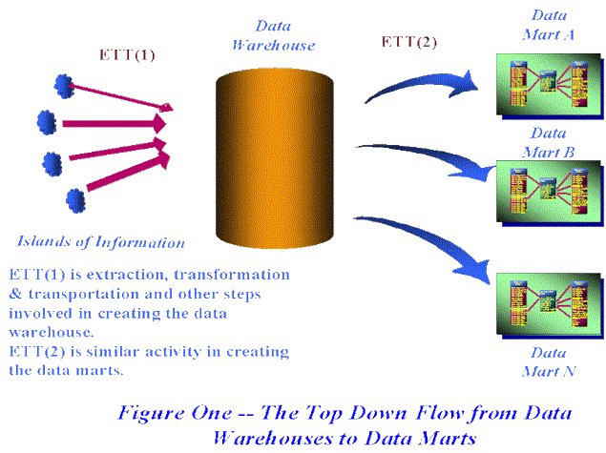
Dependent Data Marts

Slide 19
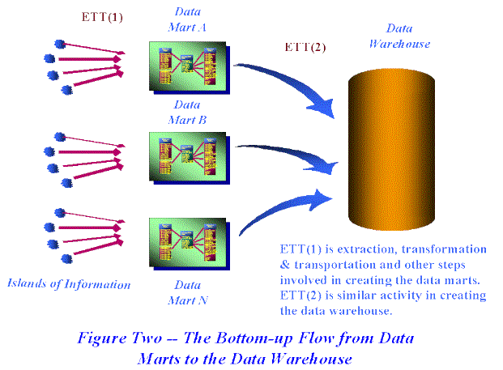
Independent Data Marts

Slide 20
The Bottom-Up Misnomer
Kimball encourages you to broaden your perspective both “vertically” and “horizontally” while gathering business requirements while developing data marts

Slide 21
The Bottom-Up Misnomer
Vertical
Don’t just rely on the business data analyst to determine requirements
Inputs from senior managers about their vision, objectives, and challenges are critical
Ignoring this vertical span might cause failure in understanding the organization’s direction and likely future trends

Slide 22
The Bottom-Up Misnomer
Horizontal
Look horizontally across the departments before designing the DW
Critical in establishing the enterprise view
Challenging to do if one particular department if funding the project
Ignoring horizontal span will create isolated, department-centric databases that are inconsistent and can’t be integrated
Complete coverage in a large organization is difficult
One rep. from each dept. interacting with the core development team can be of immense help

Slide 23
Data Warehouse or Data Mart First?
New Practical approach by Kimball
Plan and define requirements at the overall corporate level
Create a surrounding architecture for a complete warehouse
Conform and standardize the data content
Implement the Data Warehouse as a series of Supermarts, one at a time

Slide 24
A Word about SUPERMARTS
Totally monolithic approach vs. totally stovepipe approach
A step-by-step approach for building an EDW from granular data
A Supermart s a data mart that has been carefully built with a disciplined architectural framework
A Supermart is naturally a complete subset of the DW
A Supermart is based on the most granular data that can possible be collected and stored
Conformed dimensions and standardized fact definitions

Slide 25
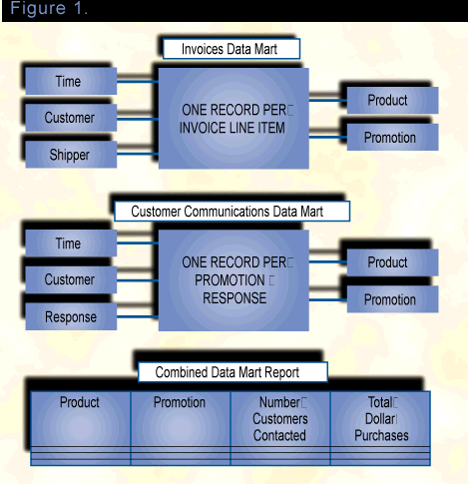
A Word about SUPERMARTS

Slide 26
Pilot Projects: Risk vs. Reward
Start with a pilot implementation as the first rollout for DW
Pilot projects have advantage of being small and manageable
Provide organization with a “proof of concept”

Slide 27
Pilot Projects: Risk vs. Reward
Functional scope of a pilot project should be determined based on:
The Degree of risk enterprise is willing to take
The potential for leveraging the pilot project
Avoid constructing a throwaway prototype
Pilot warehouse must have actual value to the enterprise

Slide 28
Pilot Projects: Risk vs. Reward
High Risk Low Reward | High Risk High reward
Low Risk Low Reward | Low Risk High Reward
RISK
REWARD

Slide 29
A Practical Approach
Most people employ a Hybrid approach with elements of Top-Down and Bottom-Up
Again, practitioners don’t always concentrate on these issues and use this terminology, and just focus on best-practice
That would include;
Build incrementally according to a business function
Employ an enterprise perspective
Dimensionally model data
Utilize conformed dimensional models
Employ a Staging Area or Data Warehouse
Store atomic data

